Slide 1
Product Innovation
Alex Xu | ADP Intern | August 7th, 2018

Slide 2
Product Innovation Team Overview
Parametric Snow Insurance
Leveraging Telematics
Key Takeaways & Acknowledgements

Slide 3
GRM Innovation
GCM Innovation
Adam L’Italien
Solaria Labs Singapore
Stefan Jacob
Executive Assistant
Sukanya Bahl
Innovation Lead
Justin Yiu
Product Owner
Graham Kennedy
Strategy and Operations
Taryn Tirrell
Trends and Insights
Jessica Decosta
Innovation Product Portfolio
Chema Luengo
Solaria Labs Boston
Chris Moss
Dir., Product
Brenton Sellati
Mgr., Special Projects
Jacob Auchincloss
Mgr., Special Projects
Chelsea Acosta Patel
ADP Summer Intern
Alex Xu
Notes:
Solaria Overview
1. GRM Innovation based in WeWork
Product Team
Bring new projects to market, either as a standalone product, or as a company driven venture
Team over in Singapore, looking to take advantage of another growing market

Slide 4
Innovation looks to fulfill Liberty’s core goal of seeking alternative sources of revenue, and drive growth
Liberty Mutual:
10% Non-Traditional Revenue
Innovation Department:
4 Ventures in 2017
Common Purpose: We deliver our customers peace of mind every day by helping them protect what they value most
Sustain Profitability (10% ROE | 95% CR)
Grow at 2x the Industry
Generate >10% Revenue from Non-Traditional Sources
Achieve Top 3 NPS
Attract and serve the mass market segment
Offer innovative and competitively priced products that meet customer needs
Provide best-in-class, omni-channel distribution access
Leading Employee, Customer and Agent Experiences
Top Talent Across the Organization
Operational Excellence
Source: https://myliberty.lmig.com/en-us/SBUorDEPTs/Personal/Our-Strategy/Pages/default.aspx
Notes:
1. Everything cumulates in Liberty’s 3rd core goal of 10% in alternative revenue and driving growth

Slide 5
Product Innovation Team Overview
Parametric Snow Insurance
Leveraging Telematics
Key Takeaways & Acknowledgements

Slide 6







Parametric Snow Insurance leverages data to provide an instant payment when a pre-defined event occurs
Time
Traditional
Insurance
$
Contract sets coverage limit
Insurable event happens
Damage assessed
Claim paid
Parametric Insurance
$
Event-Based payment model
Insurable event happens
No need to assess damage
Instant payment based on model
Snow Insurance Example
City of Cambridge buys
$20K parametric Snow policy
Snowstorm hits Cambridge
Storm data triggers payment
$20K EFT to Cambridge
8/6/2018
Notes:
Clients and Liberty agree on defined parameters related to event (that can be measured)
Payout occurs automatically when parameters are met
Run through example

Slide 7
In doing so, Parametric Snow Insurance naturally solves some pain points of traditional insurance
Purchase
Claim
Renew
Traditional
Insurance
-
-
-
“How much coverage if...”
High deductible
Home inspection
Claim forms
Lengthy process
“That’s not covered?”
Rate increase
Parametric Insurance
+
+
+
Transparent coverage
No deductible
Instant approval
Instant payment
No customer action
Low LAE; short-tailed
No rate increase due to individual claims
-
Payment may be more or less than actual loss
Insurance vs financial product
Notes:
Eased purchasing process, with only the defining the parameters being in contention
Streamlined claims process that circumvents moral conflicts
Simplified renewal process… events cannot be attributed to the faults of a client

Slide 8






We evaluate & prioritize Event-Based Insurance product opportunities through a design thinking framework
α
Consumer
Desirability
Surveys
Interviews
Alpha
Product Results
(Core & Competitors)
Feasibility
Measurable Event
Mutually agreed source of truth
Payment model
Legal & Regulatory
Technology
Viability
Goals
Align
Sustainable
Profitable
Growth
Notes:
Desirability: Is there a need or a pain point
Can we make such a product to address the pain point
Is the market product friendly (growth, profitable, likely to foster the product’s thrivability)

Slide 9
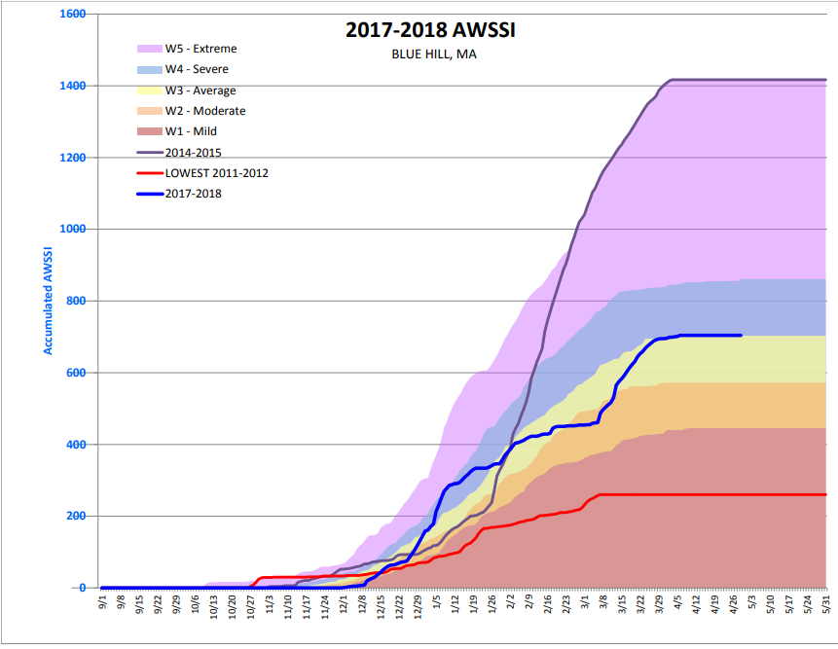
Variance of snow and ice events creates budget uncertainty for municipal governments, which is inefficient for planning
Desirability
Variant weather
Snow & ice events are unpredictable within each fiscal year and highly variant one year to the next
Budget-inelasticity
Snow & ice events require full and rapid mobilization of public works, contractors and urban forestry at little notice for unknown durations, and –
– mobilization is considered emergency work: It cannot be postponed or calibrated based on budget
Inefficient financial planning
Municipal snow & ice budgets range from 50% – 150% of the 5-year average on any given year:
millions of dollars must be held in reserve to respond to snow & ice events. This distorts budget decision-making and diverts capital away from priorities that require long-term, secure funding
(accumulated winter season
severity index)
Notes:
Desirability revealed variant weather, coupled with budget inelasticity causes inefficient financial planning
Down effects of over budgeting (tying up capital that could be otherwise used for capital projects)

Slide 10
Snow insurance for municipalities is a vitamin not a pain killer
Desirability
While the desire for such product exists, it is not critical to a Municipality’s capacity to function
"It was easier to plan for a hurricane than it is for snow and ice."
"The need is clear. [Municipalities] can't sock aside their own money. This is a potentially valuable tool for local government.“
- Shayne Kavanagh
GFOA Consultant
“A good value product, but may end up being cost prohibitive from a revenue standpoint”
- Alfred Jordan
Former Director of DPW, Detroit, Michigan
“The screw-up potential is so great with public-relations disaster.”
- Richard Davis
Independent Consultant on Public Sector Finance/Budgeting
"I view it as a hedge. It helps me sleep at night
Often asked: "why are we leaving this money sitting idle when we could return it to taxpayers?”
- Steve Krekloq
Village Admin, Germantown
Lack of market saturation despite available products
Municipals tend to self-insure out of policy, not out of fiduciary duty
Notes:
Differentiate between vitamin and painkiller
Note Shayne’s comments
Talk about lack of market saturation, self insurance, and public relations disaster

Slide 11
Only one of our two hypotheses has so far proven true
Feasibility
Hypothesis 1
On the ground sensors can reliably measure winter variables that inflate municipal snow budgets
Hypothesis 2
Liberty could predict cost overruns more accurately than our competitors by using more variables than just inches of snow
Notes:
1. Outline the hypothesis we went into the product process with

Slide 12
In alignment with our initial hypothesis, there exists a plethora of tools to measure snow related metrics
Feasibility
Hypothesis 1
On the ground sensors can reliably measure winter variables that inflate municipal snow budgets
Hypothesis 2
Liberty could predict cost overruns more accurately than our competitors by using more variables than just inches of snow
 | Oracle |  | Description |  | Advantage
 | Verisk - SNODAS |  | Verisk’s proprietary metric modeling Interpolates snow fall data for towns in between weather stations Headed by Tom Connor |  | Could give the most precise report of weather metrics
 | Weather Station Data |  | Metrics gathered from the local weather station |  | The most commonly accepted form of weather reporting
 | 3rd Party Reporting (Celsius Pro) |  | A known weather metric reporting entity for insurers, reinsurers, and weather brokers. Based out of Switzerland |  | Liberty can expect to offer the same level of precision as its competitors overseas
Notes:
Talk about SNODAS (Verisk, Tom Connor, how it works)
Brief look at weather station data
CelsiusPro overview

Slide 13
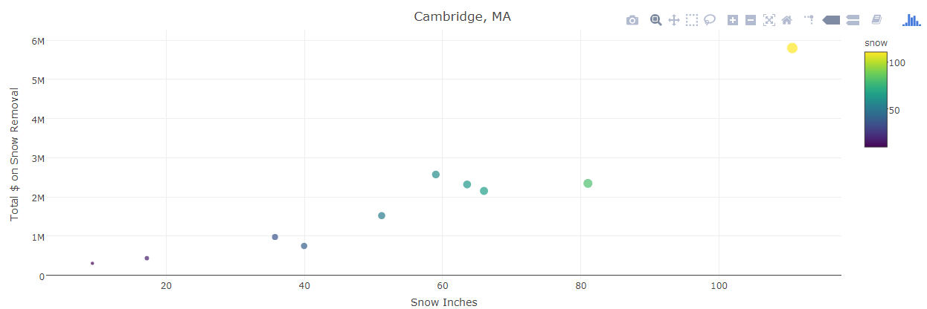
Contrary to our second hypothesis, single variable of snow-inches is similarly predictive as multivariate modeling
Feasibility
Hypothesis 1
On the ground sensors can reliably measure winter variables that inflate municipal snow budgets
Hypothesis 2
Liberty could predict cost overruns more accurately than our competitors by using more variables than just inches of snow
Notes:
Note strong correlation between snow fall and cost
Other variables were not as strongly correlated
Added them to analysis would not result in a more accurate model
Talk about variables, hypothesis of multiple variables, haven’t proved
H1: You can measure the metrics - Verisk (Measurable with) → T
H2: Beyond just snow inch (Haven’t been proven true)
Settled on snow (only)
CD for mun is OT
Traditional vs Parametric Insurance
Pains solved
Subjective claims process
Long payouts
Circumvent moral dilemmas

Slide 14
Solaria needs the backing of multiple core Liberty functions to bring this product to market - or just the Public Entities Unit
Feasibility
Solaria
Actuarial
Marketing
Liberty Mutual’s
Public Entities Unit
Claims
Finance
Legal Compliance
Notes:
1. Brief overview

Slide 15
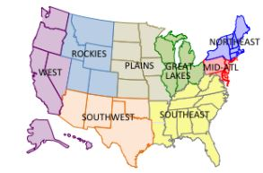
Midsize municipalities could generate $10k – $100k annually in premiums
Viability
Geographic Regions | Region Population | Municipal Spending on snow per region (Aprox)
Northeast | 57,000,000 | $ 1.2B
Mid-Atlantic | 41,660,000 | $ 408M
Great Lakes | 60,000,000 | $ 430M
Key insights
Northeast, Mid-Atlantic, Great Lakes regions constitutes approximately 67% of the snow insurance market
Snow and Ice management industry is growing annually at 3.2%
Notes:
Note the 2.B in value that needs to be protected 3 regions alone
Growth of Ice management industry translates increasing value in industry → increases insurance need
Caveat to positives: LMI is already over indexed to snow, being primarily a northeast based firm

Slide 16


Liberty has regulatory advantage over foreign competitors and there’s indications that we can undercut domestic competition
Viability
Foreign
- Sophisticated models coupled with parametric capabilities already exist
- Established markets, with firms already showing a track record of success
- Arduous U.S. insurance regulations
Domestic
- Product offering of same sophistication, is already on the market
- Early movers already have foothold on snow insurance market
- Liberty’s scale potentially enables undercutting
Threat
Counter
Notes:
Talk sophisticated, but not necessarily more accurate, foreign competitors
Use example firms (connect CelsiusPro to sompo -> note their innovation awards as example of heavy competition)
Run through domestic

Slide 17
Next steps involves gauging the interest of municipal brokers and leveraging our potential to undercut
Viability
Example of Liberty Mutual’s Potential to Undercut Domestic Competition
Liberty Mutual
$11.1K in premiums
New Bedford’s current provider
$13K in premiums
$2,500 per snow inch between 55 – 82 inches
ELR of 65%
$2,500 per snow inch above 55
Notes:
Quick outline
Next Steps: Talking with Municipal brokers to gauge interest (in this case New Bedford)

Slide 18
Product Innovation Team Overview
Parametric Snow Insurance
Leveraging Telematics
Key Takeaways & Acknowledgements

Slide 19



By utilizing cloud services, large quantities of telematics data can be analyzed through python
Notes:
Talk about importance of AWS in holding our large quants of telematics data
Explain Cortex (platform by LMI to better interact with AWS)
Data analysis and manipulation done in python, via jupyter, for faster data handling and parsing due to being written in C/C compiler, and its less object oriented with access to powerful packages.

Slide 20
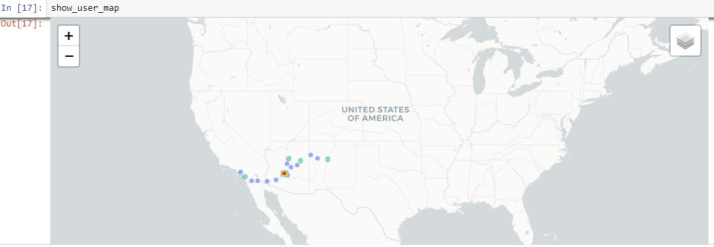
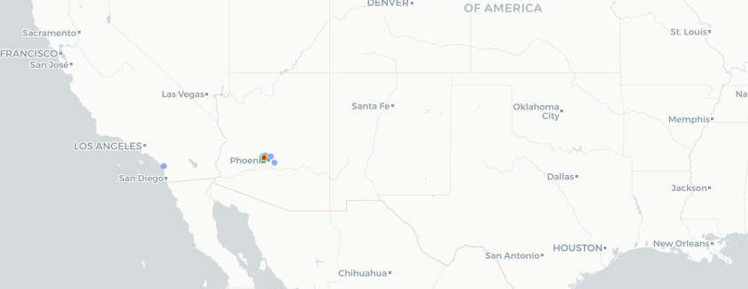
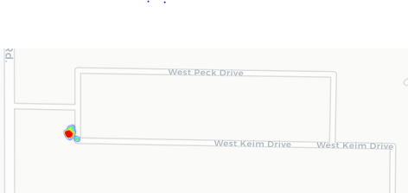
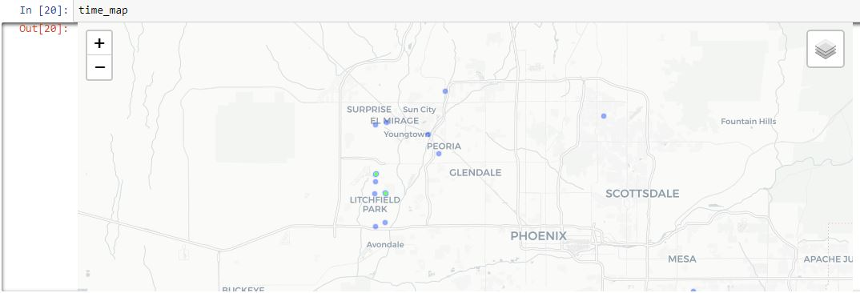
Using telematics data, we can better understand our client’s behaviors and complement other Liberty functions
User 28 Cumulative Stops
User 28 Stops (Any Given Monday)
User 28 After Hour Stops
User 28 Stops before Long Weekends/ Holidays
8/6/2018
Notes:
Give basic info on client
Walk audience through my approach
Broad/cumulative stops (over a period of time) – No activity in Idaho → Does he work there?
Yes – he does → Does he have permanent residence?
Yes – has home → Is our information on the clients wrong? → are we accommodating this client correctly, what is it that they are using the car for?
Stops around the airport before holidays and long weekends - Information may still be correct → Is this a trend among our clients → can we provide them with a better peace of mind?

Slide 21
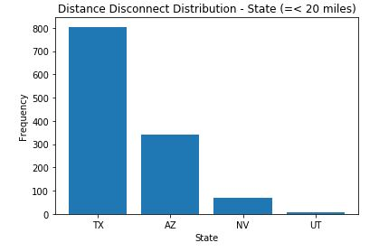
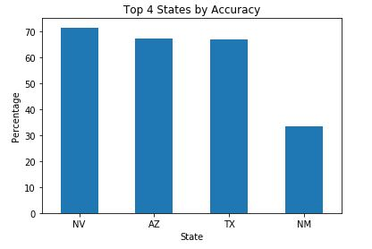
By looking deeper at driver variables, we can refine our estimation model and create value for our telematics services
Distance Distribution
Distance Distribution (Outliers Eliminated)
Top 4 States Within 20 Miles of Estimation
Top 4 States By Accuracy of Prediction
8/6/2018
Notes:
Give basic summary of the existence of our estimation model (a machine learning program takes in a user’s stops → predicts user’s zip code)
Walk through my approach example:
Look at our distance differential (Act vs Est) distribution
Eliminate outliers (Focus in on those that worked and find out why)
Break down into variables (this case states)
Focus even more → Question the numbers (Note the NM addition and TX relocation)
Mention next steps would be to dive even deeper into specific states

Slide 22
Product Innovation Team Overview
Parametric Snow Insurance
Leveraging Telematics
Key Takeaways & Acknowledgements

Slide 23


Takeaways and acknowledgements
Takeaways
Successful Teams Technical Skills
Flexible & Critical Solaria
Thinking
Thank you!
Chema Luengo
Jacob Auchincloss
Robert Elliott
Scott Gorlin
William Ma
Se Jin Park
Brenton Sellati
Chelsea Patel
Kelsie Marr
Notes:
ST: Communication, open space for objective focused feedback – Chema
Thinking: Snow and Ice hypothesis adaption
Technical skills: Data science tools
Solaria: It’s presence and value to Liberty

Slide 25
Appendix

Slide 26
By entering contracts, Liberty mitigates adverse selection
Feasibility
Points of Stress
Adverse Selection
Outlier Winters
Ramifications
Loss of Product Integrity
Overexposure to variant weather
Solution: Mid –Long term Contracts
3 – 5 Year Contracts:
Locked in insurance terms guards against bias, removing adverse selection from the process
Smooth risk out over time
Profits from “normal” years offsets losses from beyond 95th percentile winters
Notes:
(Delete Slide)
Explain the climate regions and which ones we’d be focused on.
3-5 year contracts
Guards against the potential of getting a 80th – 95th percentile winter
Adverse Seletion
Smooth Out

Slide 27
Solaria’s Product team operate under the “Jobs-to-be-Done” Theory in assessing a problem
A Job-to-be-Done is stable over time
Make “job” the unit of analysis
People want to get job done better/cheaper
A Job-to-be-Done is solution agnostic
Defining a Job
Jobs have emotional and social faces
A “Job” is what the customer is trying to accomplish | Customers want to feel and be perceived a certain way while doing their job | Jobs often don’t change, the Means/ Product does | Customers don’t know what solutions is best. Solution is independent of the current solution | Defining customer “needs” as the measured metrics leads to a more granular understanding of the Job | People aren’t loyal to companies or brands. Better is subjective
Potential Product (To be tested)
Notes:
(Delete)
1-2 work headings
1 sentence description
Very brief talk through of important bins
Delete the last 3 Descriptions
Replace with:
Customer don’t know solution
Better and cheaper, Less time/money/effort
1.
2.
3.
4. Doctor Example
5.
6. Counter to Apple argument: Consumers in tech market prioritize aesthetics and social capital, making better defined differently than pure functionality

